Slide 1

Module 4: Back End Development Frameworks & Tools
Backend Development
ID : - 2113a53245
Name : - M Lokeshraja
Batch : - A53

Slide 2



Topics Covered
API Development Services
Express.js
Node.js
MongoDB
Manual Authentication using JWT, Passport.js,etc

Slide 3
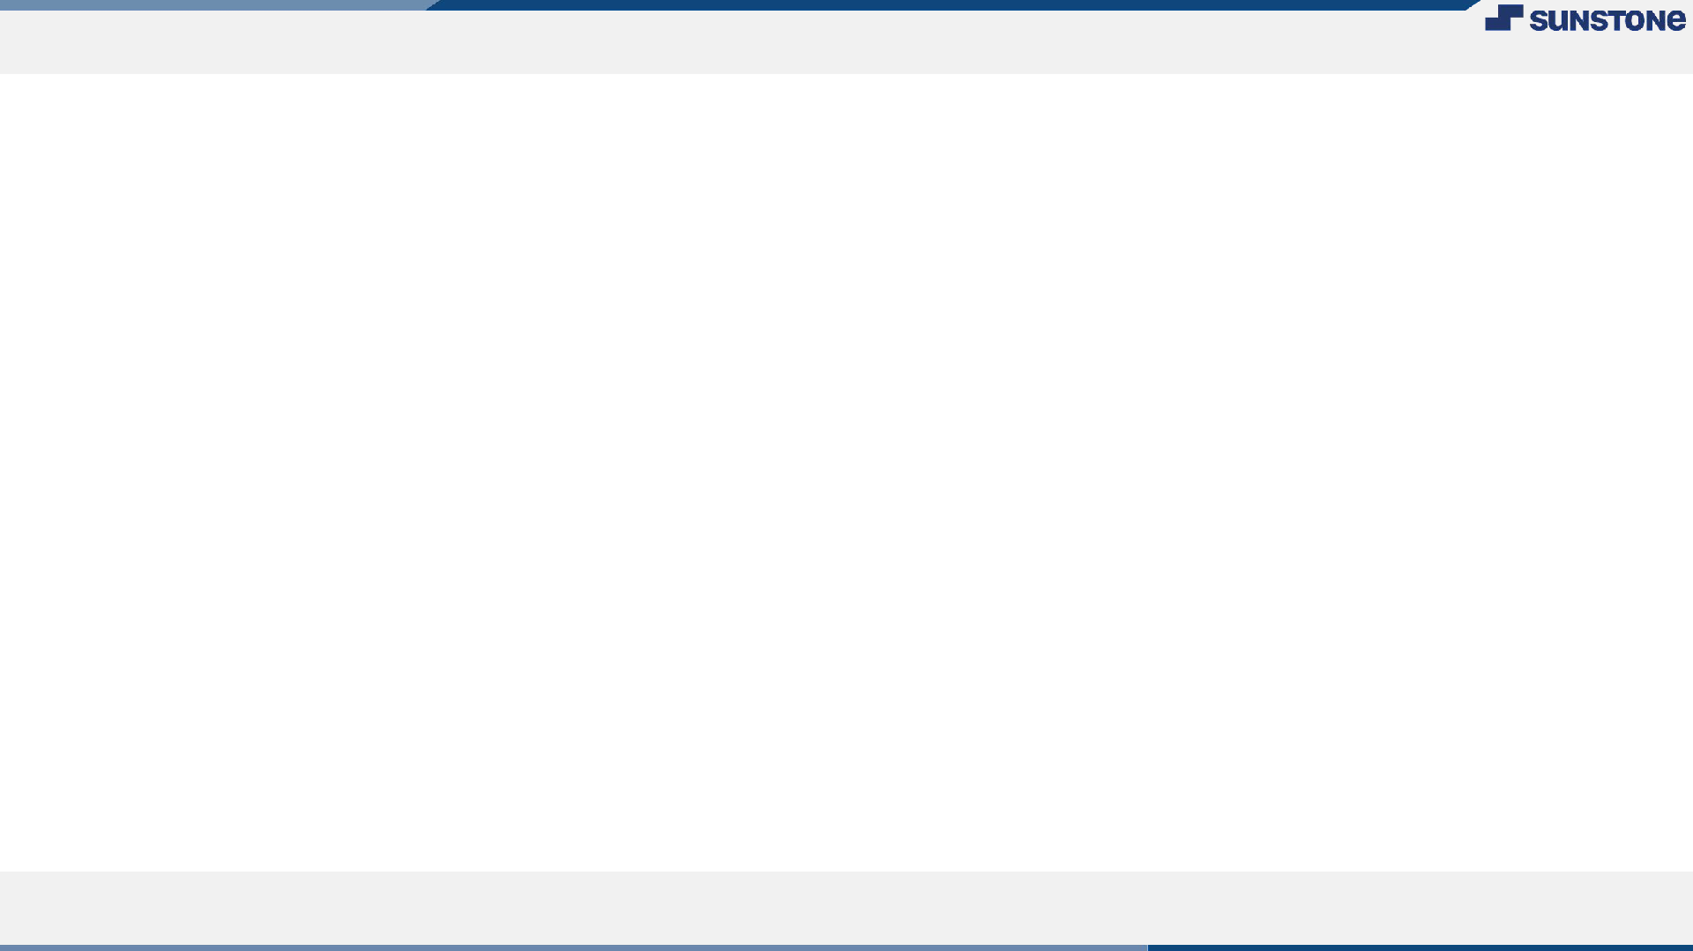
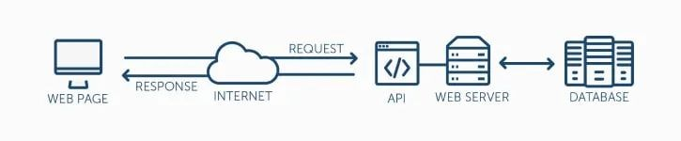
API Development Services
API (Application Programming Interface) is nothing but a set of instructions, requirements, and standards that enable an app or software to employ features or services of some other application, device, or platform to offer better services.
In technical terms, it’s a set of programming code which allows data transmission between one software product with the other. It also consists of terms of this data exchange.

Slide 4

Application programming interfaces have two components:
Technical speciﬁcation which describes the data exchange options between solutions that have speciﬁcations done in the form of data delivery protocols and request for processing.
Software interface which is written to the speciﬁcation which represents it.
In this, the software which needs the access information or functionality from software calls its API along with specifying the requirements as to how the functionality or the data should be provided. The other software simply returns the data functionality as requested by the former application. API also speciﬁes the interface by which both these applications communicate.

Slide 5
Each API is implemented by function calls which are the language statements that are used to request software to perform particular services and actions. Functions calls are nothing but phrases which includes nouns and verbs. Function calls are also described in the API documentation.
APIs can serve several purposes. Usually, they can speed up or simplify software development. Developers use APIs to add functionality from other providers to the existing solutions. Furthermore, they can be also used to develop new applications by using third-party providers.

Slide 6
Types of API
APIs can be categorized based on their release policies.
Private APIs
The interfaces of this application software are designed to improve services and solutions within the organization. Contractors as well as the in-house developers can use these APIs to build new systems.
In this scenario, the app’s interface remains available only for those people who are working with the API publisher even if the app is publically available. With a private strategy, the company can take full control of the API usage.

Slide 7
Partner APIs
Partner APIs are used for software integration between two parties. These are also openly promoted and are shared with those business partners that have signed the agreement with the publisher. A company can beneﬁt from extra revenue streams by granting its partners with capability beneﬁts and access to data.
Meanwhile, they can also monitor as to how exposed digital assets are used. Furthermore, they also ensure if the 3rd-party solutions which use their APIs offer decent user experience or not. They also ensure if they maintain corporate identity in their apps.
Composite API
Composite APIs are known for combining different service and data APIs. They are made by combining existing API functions which can perform many tasks in a single call. This boosts the execution speed along with enhancing the performance of the listeners in the web interfaces.

Slide 8
Public APIs
Public APIs are also referred to as external or developer-facing. These APIs are also available for third-party developers. Public API program enables you to increase brand awareness. Furthermore, it also allows you to receive extra income if properly executed.
Public APIs can be also classiﬁed into two categories – ﬁrst is open and the other one is commercial.
As per the Open API, all its features are public and can be used without any restrictive terms and conditions. It also states that the description and related documentation of the API must be available. Furthermore, it also says that it should be a freely available test and create applications.
If we talk about commercial API users either pay the subscription fees or use APIs on a pay-as-you-go basis. Publishers also offer free trials which enable the users to evaluate APIs before they purchase the subscription.

Slide 9
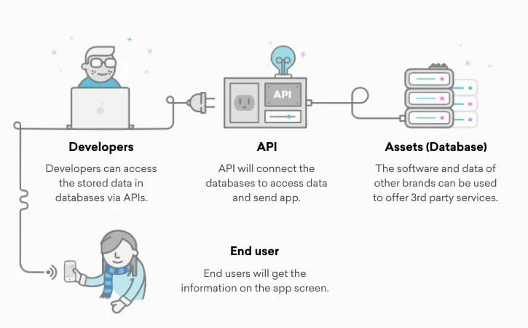
How does it work?
To understand the working of the API, let’s take an example. Assume that you have opened an ABC website or app to book a ﬂight. You ﬁlled the form by entering all the details such as departure, return date, ﬂight, city, and other respective details.

Slide 10
How does it work?
As soon as you submit, a list of ﬂights will appear with details like seat availability, timings, price, and many other details. But how did it happen? It’s because of the APIs.
To provide such accurate data, the platform sends the request to the website so that it can access the database and get all the relevant data through API. The website then responds with the data which was delivered via API to the platform.
Here, the API acts as an intermediate which streamlines the data sharing process. On the other hand, the airline website and ﬂight booking platform act as the endpoints. When it comes to communicating the endpoints, then API namely works in two ways which are SOAP and REST.
Now, that we have understood the working of APIs, let’s have a look at the basic terminologies used in API development.

Slide 11
Terminologies associated with API development
If you’re looking for a custom API development, then you must know the below terminologies.
API Key
It’s a unique code which is passed in the computer programs for authenticating user, developer, or calling program.
Endpoint
Interaction touchpoints between server and API are called Endpoint.
JSON
JSON (JavaScript Object Notion is a data format) is a data format which is used for APIs to interchange data. This interchange of data can occur between a web application and a server or two applications.

Slide 12
Terminologies associated with API development
GET
It’s a method which is used for requesting data from the server at a speciﬁed resource.
POST
It’s a method used for sending data to the API server to update or create a resource.
Oauth
It’s an open-standard authorization or authorization framework for APIs. It offers secure and restricted access to the end-users’ data which is to be used by the application or third-party websites without accessing their password.

Slide 13
Terminologies associated with API development
Latency
The time taken by the API to process a request and respond is called Latency.
Rate-limiting
The process of controlling the rate of incoming as well as outgoing trafﬁc is called rate-limiting. It’s also deﬁned as the total number of requests that a user hits to the API.
API Throttling
API throttling refers to the process in which the usage of APIs by consumers is controlled for a speciﬁc duration.

Slide 14

Tools for API development
There are many tools available when it comes to API development. Some fo the most prominent tools and products that developers use for API development are as below:
Apigee
Apigee is an API development management tool by Google. This tool is helpful when a company is updating their legacy apps or facilitating data transfer between apps and services. Apart from that, it’s also useful when a developer is building connected apps.
Dredd
Dredd is an HTTP API testing framework. It is used to validate the description of an API in the backend. It also goes through API’s description thoroughly along with determining if the API is validated or not.

Slide 15
Tools for API development
APIMatic
APIMatic is a developer experience platform for website APIs. Developers use it to generate SDKs for their APIs for 10 platforms. Furthermore, it’s also used to keep it in sync with the API updates.
This tool also enables the developers to convert API descriptions into multiple formats such as WADL, Swagger, RAML, OAI format, IO Docs, API Blueprint, HAR 1.4, Postman Collections, etc.
Sandbox
Sandbox offers a quick and easy mock RESTful API from API deﬁnitions. It also reduces the risk and cost associated with third party API calling during testing.
Postman
Postman enables app developers to evaluate the performance of the API by documenting and testing it. It’s also an interactive tool which can be set up for automation.

Slide 16
Tools for API development
SoapUI
SoapUI is an open-source testing tool. It can operate on cross-platforms. Furthermore, it can also automate both functional and non-functional tests. It is used for regression, compliance, executing, security, and load tests for the Web APIs.
Swagger
Swagger is an open-source framework which is used for API development. Big technology names such as GettyImages, Apigee, PayPal, and Microsoft use Swagger.
Jmeter
JMeter is open-source software. It’s used in performance testing of RESTful API.

Slide 17
Must-have features in API design
Before you start building APIs, you must keep a few points in your mind. These points will act as a catalyst in your API development process and will also help your team to stay on the same page. Let’s have a look at these points one by one.
Authorization and Authentication
In simple words, Authentication means verifying the right identity. On the other hand, Authorization means to decide if the veriﬁed user is permitted to perform an action on a speciﬁc source. For example, John (an authenticated user) can get a resource; however, he’s not allowed to create a resource.
OAuth, OAuth2, and JWT are some of the most commonly used speciﬁcations for managing authorization and authentication.

Slide 18
Pagination
It’s obvious that with time your database will grow. And when that happens, then you’ll observe that some of the resources are taking a longer time than usual to retrieve. The most common way to approach this situation is by caching the objects or creating pagination.
Paging is nothing but a process to determine as to how much data should be displayed and at what frequency.
Sorting also ensures that the user receives the data as per the requirements, condition applied, and modiﬁcations.
These factors help in minimising processing time, ensuring a high-level security, and a good response time.

Slide 19
Cache
By developing a Cache strategy, you can retrieve resources at a lightning speed. Once the data is ready for consumption in an in-memory database, then it will reduce the cost of your requests. You can use tools like Redis and Memcached for developing a Cache strategy.
Wrappers
API wrappers are containers or packages which are language-speciﬁc. They combine various sets of API calls into user-friendly functions. The wrapper also calls several API calls without interacting with the user.
HATEOAS
HATEOAS (Hypermedia as the Engine of Application State) is one of the modules of the REST application architecture. Here any content which consists of a link to other forms of media such as text, images, videos, etc. is called hypermedia.
HATEOS enables clients to interact with REST API with the help of responses which are provided by the server dynamically.

Slide 20
Error handling
An efﬁcient error handling can make the debugging process easier as it identiﬁes if the problem was a result of server or client error. For some errors, the client can change the request, whereas, for the others, they would require to contact support. Some of the helpful error handling methods are as follows:
Use error codes with well-known standards
Offering the right number of errors
Describing the cause of the error
Segregating domain and general errors.
Testing
API testing is very similar to software testing. API testing includes testing the APIs directly as well as the part of integration testing to ﬁnd out whether it meets the expectations for performance, functionality, security, and reliability. JMeter, Postman, and SoapUI are some of the most popular tools that are used for API testing.

Slide 21
Validation
Validation in APIs refers to the veriﬁcation of correctness of data. Validation can be categorized into two types:
Server validation
Client-side validation
In client-side validation, prompt feedback is given, for an instance marking out the incorrect entry in red color, tooltip for correction, etc.
Server-side validation involves mundane tasks such as what kind of property it is (account number, email, etc), validating if the property is required, or if the property is not needed if another property is already there.

Slide 22
Top 5 practices for building API
Above we had a look at must-have features in the API along with the top tools that are used to build API for mobile app or web app. However, all of it will go in vain if you don’t follow the correct API building practices. There a lot of API development practices.
Let’ have a look at the top 5 practices for perfect API development.
Throttling
When it comes to redirecting the overﬂow of trafﬁc, safeguarding from DoS (Denial of Service), and backup APIs, app throttling is the best practice which you all should consider.
Enable overriding HTTP method
There are some proxies, who only support POST and GET methods; this is why you must allow your RESTful API to override the HTTP method. You can do this by employing the custom HTTP Header X-HTTP-Method-Override.

Slide 23
SDK and Libraries
Offer important resources to the development team to boost the speed of services development and implementation. You can do this by offering resources which contain reusable processes and code.
Security
You must ensure that your API is secure but not at the cost of user-friendliness. If any user spends more than 5 minutes on authentication then it means that your API is far from being user-friendly. You can use
token-based authentication to make your API secure.
Documentation
Offering a wide range of documentation is another great practice that you must consider. You must create extensive documentation for an API which enables other mobile app developers to understand the entire process in detail so that they can utilize that information to provide a top-notch user experience.
In a nutshell, well-crafted API documentation will decrease the project cost, implementation time, and enhance API efﬁciency.

Slide 24
Express.js
Express is a small framework that sits on top of Node.js’s web server functionality to simplify its APIs and add helpful new features.It makes it easier to organize your application’s functionality with middle ware and routing; it adds helpful utilities to Node.js’s HTTP objects;it facilitates the rendering of dynamic HTTP objects.
Express is a part of MERN stack, a full stack JavaScript solution used in building fast, robust, and maintainable production web applications.
MongoDB(Database)
ExpressJS(Web Framework)
ReactJS(Front-end Framework)
NodeJS(Application Server)

Slide 25
Installing Express on Windows
Assuming that you have installed node.js on your system, the following steps should be followed to install express on your Windows:
STEP-1: Creating a directory for our project and make that our working directory.
$ mkdir gfg
$ cd gfg
STEP-2: Using npm init command to create a package.json ﬁle for our project.
$ npm init
Keep pressing enter and enter “yes/no” accordingly at the terminus line.

Slide 26
Installing Express on Windows
STEP-3: Installing Express
Now in your folder type the following command line:
$ npm install express –save
STEP-4: Verify that Express.js was installed on your Windows:
To check that express.js was installed on your system or not, you can run the following command line on cmd:
C:\Users\Admin\gfg\node_modules>npm --version express

Slide 27
Steps to create an Express.js Application
Step 1: Write this command in your terminal, to create a nodejs application, because our express server will work inside the node application.
Syntax: npm init
This will ask you for few conﬁgurations about your project you can ﬁll them accordingly, also you can change it later from the package.json ﬁle.
Note: Use `npm init -y` for default initialization
Step 2: Install necessary dependencies for our application. npm install express

Slide 28
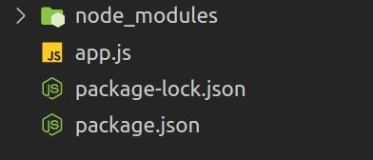
Step 3: The project structure will look like following.

Slide 29
Create a ﬁle app.js, for this article, we will write the whole express code in that ﬁle. This will be our folder structure. Now Inside app.js, Import express with require keyword and create an app by calling the express() function provided by the express framework. Set the port for our local application, 3000 is the default but you can choose any according to the availability of ports. Call the listen() function, It requires path and callback as an argument. It starts listening to the connection on the speciﬁed path, the default host is localhost, and our default path for the local machine is the localhost:3000, here 3000 is the port which we have set earlier. The callback function gets executed either on the successful start of the server or due to an error.
const express = require('express');
const app = express();
const PORT = 3000;

Slide 30
app.listen(PORT, (error) =>{
if(!error)
console.log("Server is Successfully Running, and App is listening on port "+ PORT)
else
console.log("Error occurred, server can't start", error);
}
);

Slide 31
Step to run the application: Now as we have created a server we can successfully start running it to see it’s working, write this command in your terminal to start the express server.
node app.js
Now with all of this, we have created and run the server successfully, if your server is not starting then there may be some error, try to analyze and read that error and resolve it accordingly.
Finally, after a successful run if you try to open the URL (localhost:3000) on the browser it will show you cannot GET / because we have not conﬁgured any route on this application yet.
Step 4: Now we will set all the routes for our application.
Routes are the endpoints of the server, which are conﬁgured on our backend server and whenever someone tries to access those endpoints they respond accordingly to their deﬁnition at the backend. If you’re a beginner you can consider route as a function that gets called when someone requests the special path associated with that function and return the expected value as a response. We can create routes for HTTP methods like get, post, put, and so on.
Syntax: The basic syntax of these types of routes looks like this, the given function will execute when the path and the request method resemble.
app.anyMethod(path, function)

Slide 32
Example 1: Setting up a basic get request route on the root URL (‘/’ path) of the server.
With app.get() we are conﬁguring our ﬁrst route, it requires two arguments ﬁrst one is the path and, the second one is a function that will be executed when anyone requests this path with GET method. The express provides the request and response object as a parameter to all such types of functions.
The req is a giant object which will be received from the user and res is an object which will be sent to the user after the function ﬁnishes execution.
Later we are calling status() method it takes an HTTP status code as an argument and when the response is returned, the status will be sent along.
Finally, we are returning the response to the user. The send() method takes a string, object, array, or buffer as an argument and is used to send the data object back to the client as an HTTP response, also there are lots of types of response in express like res.json() which is used to send JSON object, res.sendFile() which is used to send a ﬁle, etc.

Slide 33

const express = require('express');
const app = express();
const PORT = 3000;
app.get('/', (req, res)=>{
res.status(200);
res.send("Welcome to root URL of Server");
});

Slide 34
app.listen(PORT, (error) =>{
if(!error)
console.log("Server is Successfully Running, and App is listening on port "+ PORT)
else
console.log("Error occurred, server can't start", error);
}
);

Slide 35
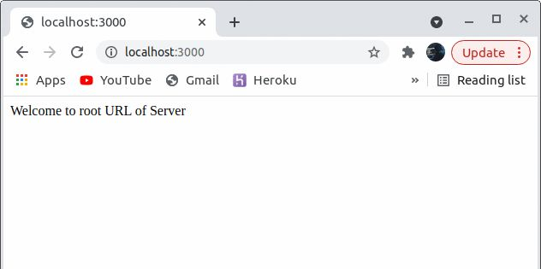
Step to run the application: Save this code, restart the server, and open the localhost on the given port. When client request with the appropriate method on the speciﬁed path ex: GET request on ‘/’ path, our function is returning the response as plain text If we open the network section in chrome developers tools (press Ctrl+Shift+I to open) we will see the response returned by the localhost along with all information.

Slide 36

Step 5: Now we will see how to send data to server.
Sometimes we have to send our data to the server for processing, for example when you try to log in on Facebook you send a password and email to the server, Here we will see how to receive data from the user request. We can send data with the request object on the speciﬁed path with appropriate HTTP methods. Till now we were using the browser to interact with the server, but in this step, any tool or frontend form is must be needed to send data because the browser search bar can only send get requests to receive resources from the server.

Slide 37

Example: Setting up a route to be accessed by users to send data with post requests.
Before creating a route for receiving data, we are using an inbuilt middleware, Middleware is such a broad and more advanced topic so we are not going to discuss it here, just to understand a little bit you can think of this as a piece of code that gets executed between the request-response cycles.
The express.json() middleware is used to parses the incoming request object as a JSON object. The app.use() is the syntax to use any middleware.
After then we have created a route on path ‘/’ for post request.
const {name}, which is the syntax in ES6 to extract the given property/es from the object. Here we are extracting the name property which was sent by the user with this request object.
After that, we are simply sending a response to indicate that we have successfully received data. If this
`${} ` is looking weird to you then let me tell you that it is the syntax in ES6 to generate strings with javascript expression in ES6. We can inject any javascript expression inside ${}.

Slide 38
const express = require('express');
const app = express();
const PORT = 3000;
app.use(express.json());
app.post('/', (req, res)=>{ const {name} = req.body;
res.send(`Welcome ${name}`);
})

Slide 39
app.listen(PORT, (error) =>{
if(!error)
console.log("Server is Successfully Running, and App is listening on port "+ PORT)
else
console.log("Error occurred, server can't start", error);
}
);

Slide 40

Step to run the application:
We are Accessing the route with Postman. It is a tool to test APIs, we can use any other things like Axios, fetch, or any other thing from the frontend or cURL from the terminal, but that will make you divert from the topic, just keep in mind that our express server only demands a path with request object it doesn’t matter from where it is coming. We have sent the data as a JSON object with the request body and express is sending a response back to us along with the data. It indicates that our goal to send data to the server succeeded.

Slide 41
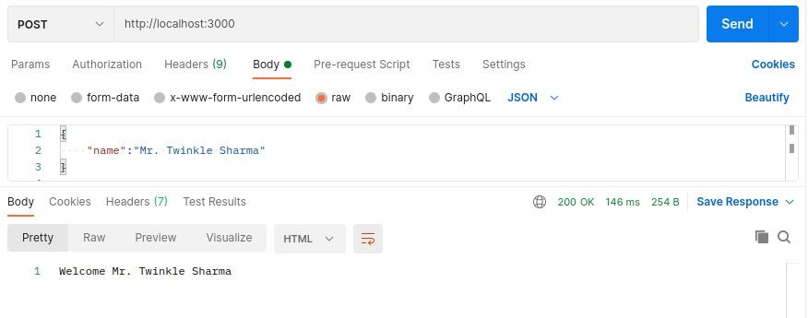

Slide 42

Step 5: Sending Files from Server
Step 6: Now we will see how to send ﬁles from the server.
Several times we need to transfer the resources from the server as per user request, there are majorly two methods to send ﬁles one is sending static ﬁles using middleware and the other one is sending a single ﬁle on a route.
This is our folder structure and we want to serve the ﬁles from the Static Files directory as static ﬁles, and the image.jpg on a separate route.

Slide 43
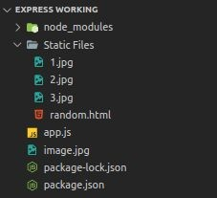

Slide 44

Example 1: Serving entire directory using middleware
Express provides us a middleware express.static(), it accepts two arguments ﬁrst one is the absolute root path of the directory whose ﬁles we are going to serve.
We can simply use it to serve static ﬁles, by providing to app.use(). Syntax:
app.use(path, express.static(root, [options]));
First of all, we are importing an inbuilt module `path`, because later we are going to use one of the functions provided by this module.
We are simply mounting a middleware at the ‘/static’ route.
The static() middleware requires an absolute path so we use the path module’s join method.
The join() method takes two parameters and joins them as a path, in NodeJS we have a global attribute __dirname which contains the path of the directory in which the current ﬁle exists.
We are providing that joined path to middleware so that it can start serving the ﬁles inside that directory on the given path.

Slide 45
const express = require('express');
const app = express();
const PORT = 3000;
const path = require('path')
app.use('/static', express.static(path.join(__dirname, 'Static Files')))

Slide 46
app.listen(PORT, (error) =>{
if(!error)
console.log("Server is Successfully Running, and App is listening on port "+ PORT)
else
console.log("Error occurred, server can't start", error);
}
);

Slide 47
Node.js
Node.js is an open-source and cross-platform runtime environment for executing JavaScript code outside a browser. You need to remember that NodeJS is not a framework and it’s not a programming language. Most people are confused and understand it’s a framework or a programming language. We often use Node.js for building back-end services like APIs like Web App or Mobile App. It’s used in production by large companies such as Paypal, Uber, Netﬂix, Walmart, and so on.

Slide 48
Features of NodeJS:
There are other programming languages also which we can use to build back-end services so what makes Node.js different I am going to explain.
It’s easy to get started and can be used for prototyping and agile development
It provides fast and highly scalable services
It uses JavaScript everywhere, so it’s easy for a JavaScript programmer to build back-end services using Node.js
Source code cleaner and consistent.
Large ecosystem for open source library.
It has Asynchronous or Non-blocking nature.

Slide 49
Advantages of NodeJS:
Easy Scalability: Developers prefer to use Node.js because it is easily scaling the application in both horizontal and vertical directions. We can also add extra resources during the scalability of the application.
Real-time web apps: If you are building a web app you can also use PHP, and it will take the same amount of time when you use Node.js, But if I am talking about building chat apps or gaming apps Node.js is much more preferable because of faster synchronization. Also, the event loop avoids HTTP overloaded for Node.js development.
Fast Suite: NodeJs runs on the V8 engine developed by Google. Event loop in NodeJs handles all asynchronous operation so NodeJs acts like a fast suite and all the operations can be done quickly like reading or writing in the database, network connection, or ﬁle system

Slide 50
Advantages of NodeJS:
Easy to learn and code: NodeJs is easy to learn and code because it uses JavaScript. If you are a front-end developer and have a good grasp of JavaScript you can easily learn and build the application on NodeJS
Advantage of Caching: It provides the caching of a single module. Whenever there is any request for the ﬁrst module, it gets cached in the application memory, so you don’t need to re-execute the code.
Data Streaming: In NodeJs HTTP request and response are considered as two separate events. They are data stream so when you process a ﬁle at the time of loading it will reduce the overall time and will make it faster when the data is presented in the form of transmissions. It also allows you to stream audio and video ﬁles at lightning speed.

Slide 51
Advantages of NodeJS:
Hosting: PaaS (Platform as a Service) and Heroku are the hosting platforms for NodeJS application deployment which is easy to use without facing any issue.
Corporate Support: Most of the well-known companies like Walmart, Paypal, Microsoft, Yahoo are using NodeJS for building the applications. NodeJS uses JavaScript, so most of the companies are combining front-end and backend Teams together into a single unit.

Slide 52
Application of NodeJS:
NodeJS should be preferred to build:
Real-Time Chats,
Complex Single-Page applications,
Real-time collaboration tools,
Streaming apps
JSON APIs based application

Slide 53
Setting up the Node Development Environment
The Node can be installed in multiple ways on a computer. The approach used by you depends on the existing development environment in the system. There are different package installer for different environments. You can install Node by grabbing a copy of the source code and compiling the application. Another way of installing Node is by cloning the GIT repository in all the three environments and then installing it on the system.

Slide 54
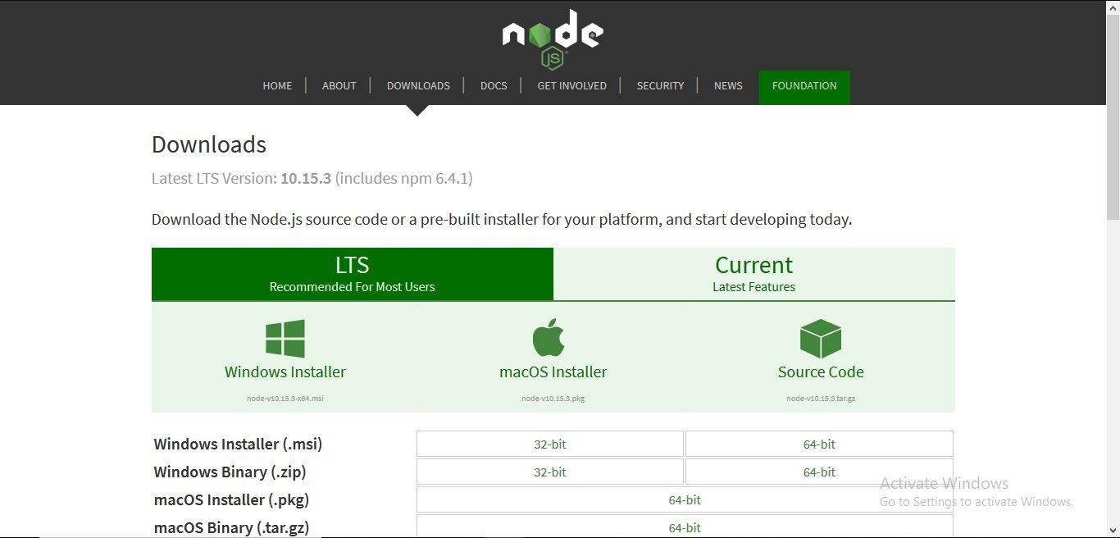
Step-1: Downloading the Node.js ‘.msi’ installer.
The ﬁrst step to install Node.js on windows is to download the installer. Visit the ofﬁcial Node.js website i.e) https://nodejs.org/en/download/ and download the .msi ﬁle according to your system environment (32-bit & 64-bit). An MSI installer will be downloaded on your system.

Slide 55
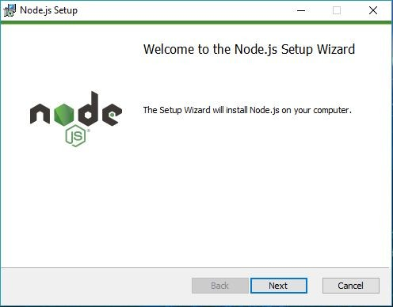
Step-2: Running the Node.js installer.
Now you need to install the node.js installer on your PC. You need to follow the following steps for the Node.js to be installed:-
Double click on the .msi installer.
The Node.js Setup wizard will open.
Welcome To Node.js Setup Wizard.
Select “Next”

Slide 56
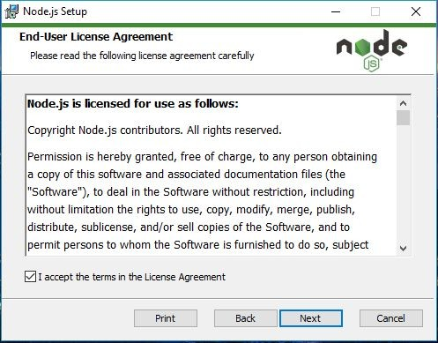
After clicking “Next”, End-User License Agreement (EULA) will open.
Check “I accept the terms in the License Agreement”
Select “Next”

Slide 57
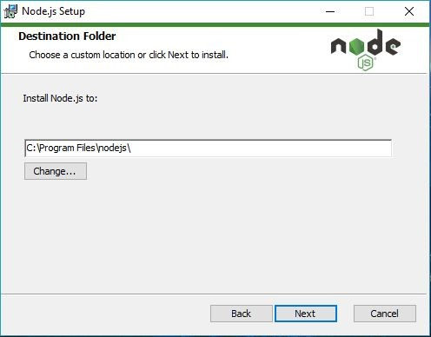
Destination Folder
Set the Destination Folder where you want to install Node.js & Select “Next”

Slide 58
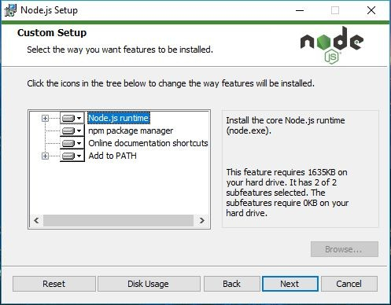
Custom Setup
Select “Next”

Slide 59
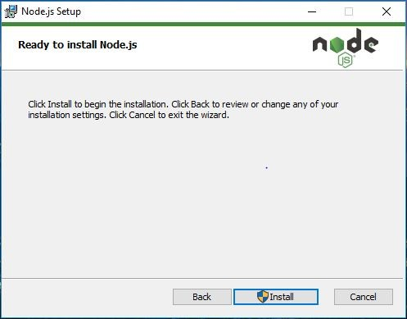
Ready to Install Node.js.
Select “Install”

Slide 60
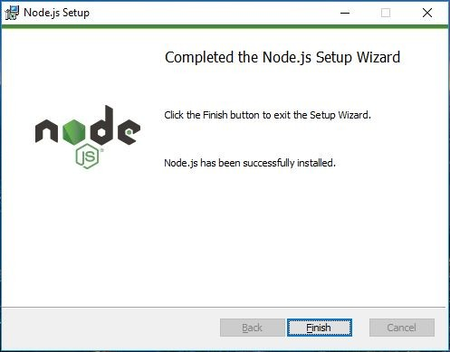
A prompt saying –“This step requires administrative privileges” will appear. Authenticate the prompt as an “Administrator”Installing Node.js.
Do not close or cancel the installer until the install is complete
Complete the Node.js Setup Wizard.
Click “Finish”

Slide 61
Step 3: Verify that Node.js was properly installed or not.
To check that node.js was completely installed on your system or not, you can run the following command in your command prompt or Windows Powershell and test it:-
C:\Users\Admin> node -v

Slide 62
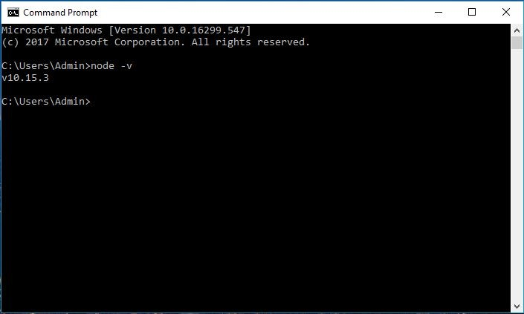

Slide 63
Step 4: Updating the Local npm version.
The ﬁnal step in node.js installed is the updation of your local npm version(if required) – the package manager that comes bundled with Node.js.
You can run the following command, to quickly update the npm npm install npm –global // Updates the ‘CLI’ client

Slide 64
Node.js Basics
Datatypes: Node.js contains various types of data types similar to JavaScript.
Boolean
Undeﬁned
Null
String
Number

Slide 65
Loose Typing:
Node.js supports loose typing, it means you don’t need to specify what type of information will be stored in a variable in advance. We use var keyword in Node.js to declare any type of variable. Examples are given below:
// Variable store number data type var a = 35;
console.log(typeof a);
// Variable store string data type
a = "GeeksforGeeks"; console.log(typeof a);

Slide 66
// Variable store Boolean data type
a = true; console.log(typeof a);
// Variable store undeﬁned (no value) data type
a = undeﬁned; console.log(typeof a);

Slide 67
Output:
number
string
boolean
undeﬁned

Slide 68
Objects & Functions: Node.js objects are same as JavaScript objects i.e. the objects are similar to variable and it contains many values which are written as name : value pairs. Name and value are separated by colon and every pair is separated by comma.
Example:
var company = {
Name: "Sunstone Eduversity", Address: "Gurugram", Contact: "+919876543210",
Email: "abc@sunstoneeduversity.org"
};

Slide 69
// Display the object information
console.log("Information of variable company:", company);
// Display the type of variable
console.log("Type of variable company:", typeof company);

Slide 70
Output:
Information of variable company: {
Name: 'Sunstone Eduversity', Address: Gurugram', Contact: '+919876543210',
Email: 'abc@sunstoneeduversity.org'
}
Type of variable company: object

Slide 71
Functions: Node.js functions are deﬁned using function keyword then the name of the function and parameters which are passed in the function. In Node.js, we don’t have to specify datatypes for the parameters and check the number of arguments received. Node.js functions follow every rule which is there while writing JavaScript functions.
Example:
function multiply(num1, num2) {
// It returns the multiplication
// of num1 and num2 return num1 * num2;
}

Slide 72
// Declare variable
var x = 2; var y = 3;
// Display the answer returned by
// multiply function console.log("Multiplication of", x,
"and", y, "is", multiply(x, y)); Output:
Multiplication of 2 and 3 is 6

Slide 73
String and String Functions: In Node.js we can make a variable as string by assigning a value either by using single (”) or double (“”) quotes and it contains many functions to manipulate to strings.
Following is the example of deﬁning string variables and functions in node.js.
Example:
var x = "Welcome to Sunstone Eduversity"; var y = 'Node.js Tutorials';
var z = ['Sunstone', 'Eduversity']; console.log(x);
console.log(y);

Slide 74
console.log("Concat Using (+) :", (x + y));
console.log("Concat Using Function :", (x.concat(y)));
console.log("Split string: ", x.split(' '));
console.log("Join string: ", z.join(', '));
console.log("Char At Index 5: ", x.charAt(5) );

Slide 75
Welcome to Sunstone Eduversity
Node.js Tutorials
Concat Using (+) : Welcome to Sunstone Eduversity Node.js Tutorials Concat Using Function : Welcome to Sunstone Eduversity Node.js Tutorials Split string: [ 'Welcome', 'to', 'Sunstone Eduversity', '' ]
Join string: Sunstone, Eduversity Char At Index 5: m

Slide 76
Node.js web-based application: Node.js web application contains different types of modules which is imported using require() directive and we have to create a server and write code for the read request and return response.
Make a ﬁle web.js with the following code.
// Require http module
var http = require("http");
// Create server http.createServer(function (req, res) {
// Send the HTTP header
// HTTP Status: 200 : OK
// Content Type: text/plain

Slide 77
res.writeHead(200, {'Content-Type': 'text/plain'});
// Send the response body as "This is the example
// of node.js web based application"
res.end('This is the example of node.js web-based application \n');
// Console will display the message
}).listen(5000,
()=>console.log('Server running at http://127.0.0.1:5000/'));

Slide 78
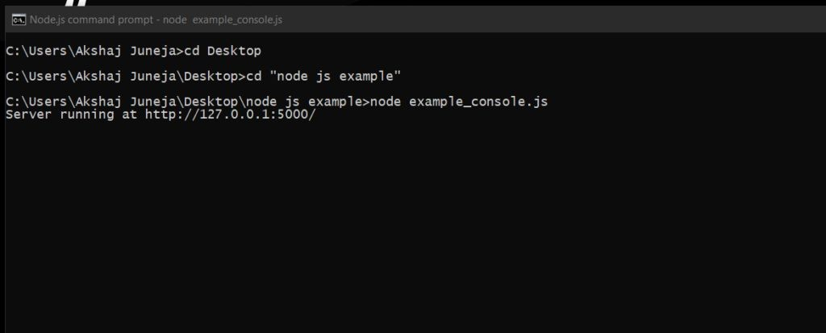
To run this ﬁle follow the steps as given below:
Search the node.js command prompt in the search bar and open the node.js command prompt.
Go to the folder using cd command in command prompt and write the following command node web.js

Slide 79
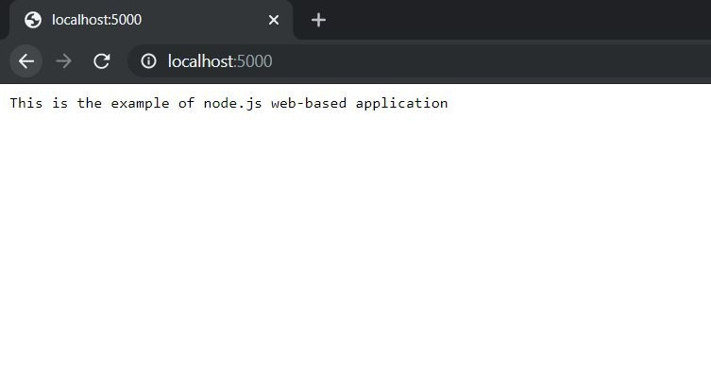
Now the server has started and go to the browser and open this url localhost:5000

Slide 80
MongoDB
MongoDB, the most popular NoSQL database, is an open-source document-oriented database. The term ‘NoSQL’ means ‘non-relational’. It means that MongoDB isn’t based on the table-like relational database structure but provides an altogether different mechanism for storage and retrieval of data. This format of storage is called BSON ( similar to JSON format).
A simple MongoDB document Structure:

Slide 81
{
title: 'Sunstone Eduversity', by: 'Akshaj Juneja',
url: 'https://www.sunstone.in', type: 'NoSQL'
}

Slide 82

SQL databases store data in tabular format. This data is stored in a predeﬁned data model which is not very much ﬂexible for today’s real-world highly growing applications. Modern applications are more networked, social and interactive than ever. Applications are storing more and more data and are accessing it at higher rates.
Relational Database Management System(RDBMS) is not the correct choice when it comes to handling big data by the virtue of their design since they are not horizontally scalable. If the database runs on a single server, then it will reach a scaling limit. NoSQL databases are more scalable and provide superior performance. MongoDB is such a NoSQL database that scales by adding more and more servers and increases productivity with its ﬂexible document model.

Slide 83
RDBMS vs MongoDB:
RDBMS has a typical schema design that shows number of tables and the relationship between these tables whereas MongoDB is document-oriented. There is no concept of schema or relationship.
Complex transactions are not supported in MongoDB because complex join operations are not available.
MongoDB allows a highly ﬂexible and scalable document structure. For example, one data document of a collection in MongoDB can have two ﬁelds whereas the other document in the same collection can have four.

Slide 84
RDBMS vs MongoDB:
MongoDB is faster as compared to RDBMS due to efﬁcient indexing and storage techniques.
There are a few terms that are related in both databases. What’s called Table in RDBMS is called a Collection in MongoDB. Similarly, a Table is called a Document and A Column is called a Field. MongoDB provides a default ‘_id’ (if not provided explicitly) which is a 12-byte hexadecimal number that assures the uniqueness of every document. It is similar to the Primary key in RDBMS.

Slide 85
Features of MongoDB:
Document Oriented: MongoDB stores the main subject in the minimal number of documents and not by breaking it up into multiple relational structures like RDBMS. For example, it stores all the information of a computer in a single document called Computer and not in distinct relational structures like CPU, RAM, Hard disk, etc.
Indexing: Without indexing, a database would have to scan every document of a collection to select those that match the query which would be inefﬁcient. So, for efﬁcient searching Indexing is a must and MongoDB uses it to process huge volumes of data in very less time.

Slide 86
Features of MongoDB:
Scalability: MongoDB scales horizontally using sharding (partitioning data across various servers). Data is partitioned into data chunks using the shard key, and these data chunks are evenly distributed across shards that reside across many physical servers. Also, new machines can be added to a running database.
Replication and High Availability: MongoDB increases the data availability with multiple copies of data on different servers. By providing redundancy, it protects the database from hardware failures. If one server goes down, the data can be retrieved easily from other active servers which also had the data stored on them.
Aggregation: Aggregation operations process data records and return the computed results. It is similar to the GROUPBY clause in SQL. A few aggregation expressions are sum, avg, min, max, etc

Slide 87
Where do we use MongoDB?
MongoDB is preferred over RDBMS in the following scenarios:
Big Data: If you have huge amount of data to be stored in tables, think of MongoDB before RDBMS databases. MongoDB has built-in solution for partitioning and sharding your database.
Unstable Schema: Adding a new column in RDBMS is hard whereas MongoDB is schema-less. Adding a new ﬁeld does not effect old documents and will be very easy.
Distributed data Since multiple copies of data are stored across different servers, recovery of data is instant and safe even if there is a hardware failure.

Slide 88
Terminologies:
A MongoDB Database can be called as the container for all the collections.
Collection is a bunch of MongoDB documents. It is similar to tables in RDBMS.
Document is made of ﬁelds. It is similar to a tuple in RDBMS, but it has dynamic schema here.
Documents of the same collection need not have the same set of ﬁelds

Slide 89
After you install MongoDB, you can see all the installed ﬁle inside C:\ProgramFiles\MongoDB\ (default location). In the C:\Program Files\MongoDB\Server\3.2\bin directory, there are a bunch of executables and a short-description about them would be:
mongo: The Command Line Interface to interact with the db. mongod: This is the database. Sets up the server. mongodump: It dumps out the Binary of the Database(BSON) mongoexport: Exports the document to Json, CSV format mongoimport: To import some data into the DB. mongorestore: to restore anything that you’ve exported. mongostat: Statistics of databases

Slide 90
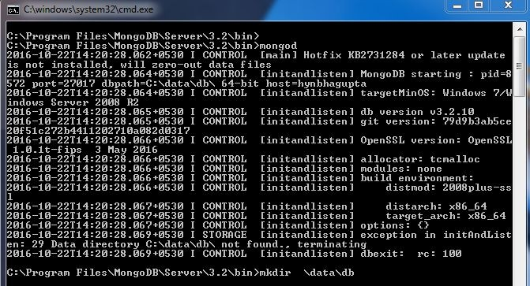
Now, you can start running the MongoDB Server. Fire up a Command Prompt and go to the location where MongoDB executables are installed (C:\Program Files\MongoDB\Server\3.2\bin\ but this path might change in future). Just type “mongod” and it will pop an error saying the path \data\db doesn’t exist:

Slide 91
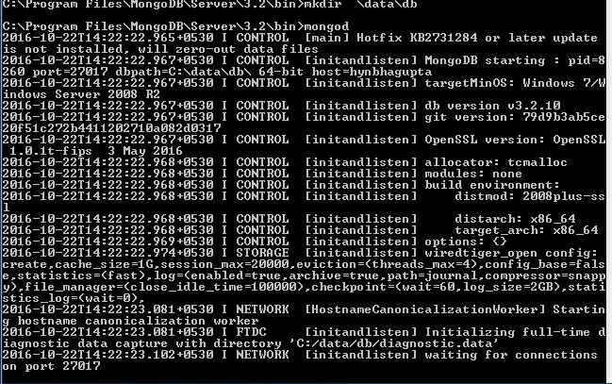
This means that the default path of storage C:\data\db was not found. So you can make a directory C:\data\db on your own or with the mkdir command. You can also change the default path by the switch –dbpath <path> with the “mongod” command.
After making this directory, run the “mongod” command again and it will start the server on the port 27017.

Slide 92
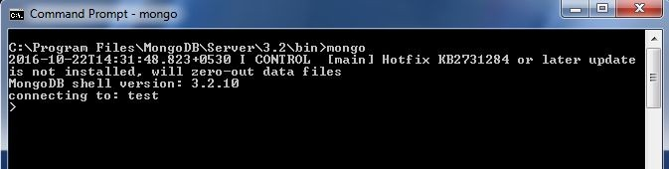
Now, we need to start our client. So, open up another terminal and change the directory to the MongoDB path. Just type “mongo” and your client would be up, trying to connect to the server.

Slide 93
This would be the CLI to interact and administer the databases. This shell is kind-of a JS console. You can try in different JS commands to check that out. Since our client is up, we can now start working on the database. We can see that the database in use is named as “test”. You can see the databases using “see dbs” and switch to other databases like “local” by typing “use <dbname>”.
Note that there are no existing collections. This can be seen by typing the command “show collections”.
Let’s start by adding some data into our database. We can create a collection by the method db.createCollection(name, { size : …, capped : …, max : … } )

Slide 94
But we have created a randomly generated json ﬁle( of employee data) and we would import it onto our database by typing
mongoimport --jsonArray --db test --collection employee_data <
C:\mongoJson\employee_data.json
This would import the Employee data json document referred by the path given in the collection named “employee_data” of database “test”.

Slide 95
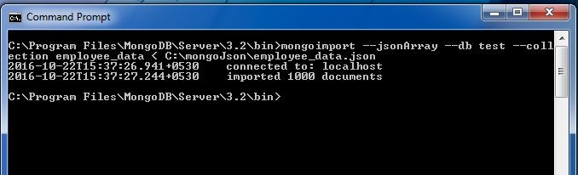

Slide 96
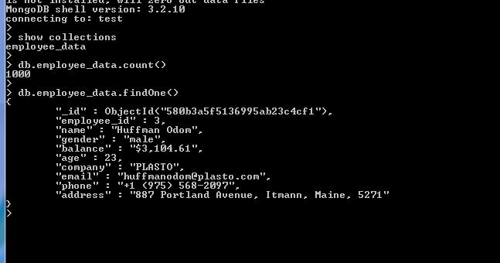
Now to ensure the collection is imported you can type “show collections” in the shell. You can use methods like count(), ﬁnd(), ﬁndOne() to do some very basic queries with your document.
You can see that in every document there is a ﬁeld called “_id” which was not provided in the data imported. The reason is that MongoDB provides a default “_id” (if not provided explicitly) which is a 12 byte hexadecimal number which assures the uniqueness of every document. You can even change this “_id” ﬁeld but this is not recommended.

Slide 97
Indexing: You can also use indexing if your query returns more than one document. For example, db.employee_data.ﬁnd() returns all the documents in the collection but if you just want the 7th one then, just do db.employee_data.ﬁnd()[6] and it will return the speciﬁc document. [Note : Indexing starts from 0 here].
Projections: Let’s say for a query you want only some speciﬁc details and not the whole set of detail in the document. You can use projections for this. After your query object just make the needed ﬁelds as 1 and others would be assumed as 0 automatically. But remember that the “_id” ﬁeld is always assumed to be 1 implicitly and if you don’t want to see the ugly looking “_id” ﬁeld, then you need to say this in your projection by “_id : 0”

Slide 98
Queries
1. Find the number of employees with company “Sunstone Eduversity”
db.employee_data.ﬁnd( { company= “Sunstone Eduversity” } ).count()
2. Show the detail of all the employees named “Akshay Juneja”
db.employee_data.ﬁnd( { name: “Akshay Juneja” }

Slide 99
3. Show the age, gender and email, but not “_id” of the employee named “Akshay Juneja”. (Assume that there is only one employee named Akshay Juneja). Usage of Projections
db.employee_data.ﬁnd( { name: “Akshay Juneja” }, { _id:0, age:1, gender:1, email:1 } )
We can also store the output of queries into variables and then make interesting queries with them too.

Slide 100
4. Print the name of all the female employees.
var femaleEmp = db.employee_data.ﬁnd( { gender: “female” } )
for ( var i = 0 ; i < femaleEmp.count() ; i++){ print ( femaleEmp[i].name)
}
db.employee_data.ﬁnd( { gender: "female" }, { _id:0, name:1 } )
Note that the 1st solution just prints out the names while 2nd one prints it in Object Format.

Slide 101
Manual Authentication using JWT, Passport.js
When building a web application, authentication is one of the important aspects, and we usually implement authentication using JWT tokens (You can learn more about JWT here). We create an access token and store it in the local storage or session or cookie. But there is a more secure way to implement this using Refresh Tokens.
Refresh Tokens: It is a unique token that is used to obtain additional access tokens. This allows you to have short-lived access tokens without having to collect credentials every time one expires.

Slide 102
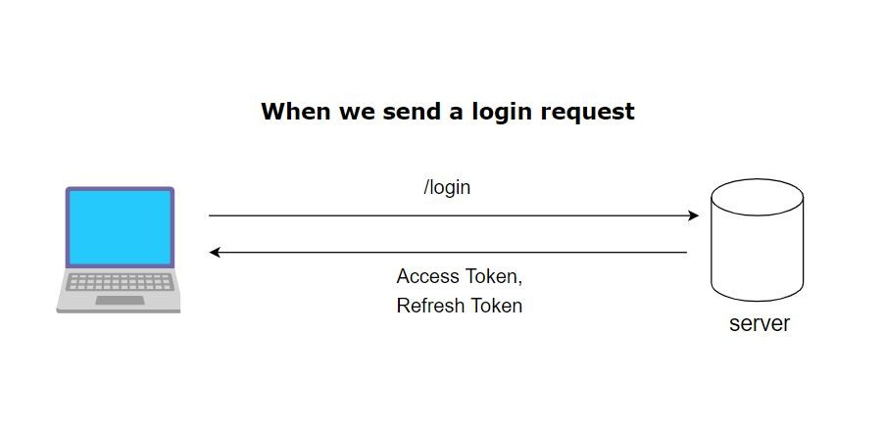
Since access tokens aren’t valid for an extended period because of security reasons, a refresh token helps to re-authenticate a user without login credentials. This Refresh token is never exposed to the client-side Javascript, even if our access token gets compromised it’ll be expired in a very short duration. So, we will be sending two tokens instead of one, an access token and a refresh token. The access token will contain all the user information and will be stored in Javascript runtime, but the refresh token will be stored securely in an
HTTP-only cookie.

Slide 103
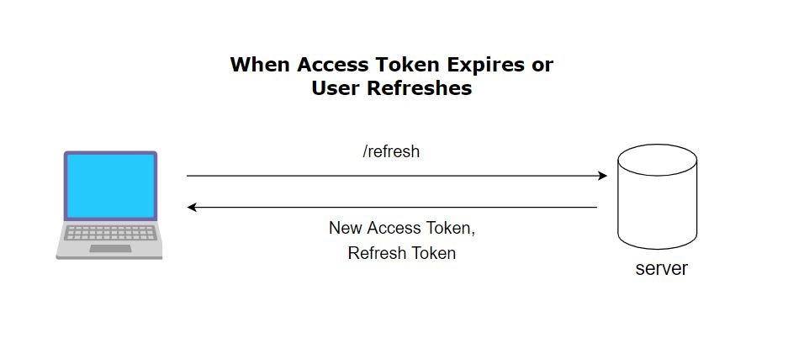
Auth Persistence: We can easily persist users between refreshes and login without any credentials. We can create a new route called refresh, whenever a token expires or a user refreshes we can get a new access token by sending a request to this route

Slide 104
Step 1: Run the following commands to initialize the project and create an index ﬁle & env ﬁle. (Make sure you have node and npm installed)
npm init -y
touch index.js .env
Step 2: Install all the required dependencies and open the project in the code editor. npm install express cookie-parser dotenv jsonwebtoken

Slide 105
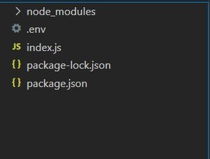
Project Structure:
We will write our authentication logic in Index.js. We’ll ﬁrst create an express app and then implement two routes login & refresh. The login route will get a post request, then it will check the credentials if they match it’ll send a refresh token and access token in response. The refresh route will also get a post request it’ll verify the refresh token, if it is correct then it will respond with a new access token otherwise throw an authorization error.

Slide 106
Example: We will now implement two routes login & refresh. The below code is for index.js:
const dotenv = require('dotenv'); const express = require('express');
const cookieparser = require('cookie-parser'); const jwt = require('jsonwebtoken')
const bodyParser = require('body-parser');

Slide 107
// Conﬁguring dotenv
dotenv.conﬁg();
const app = express();
// Setting up middlewares to parse request body and cookies
app.use(express.json()); app.use(express.urlencoded({ extended: false })); app.use(cookieparser());

Slide 108
const userCredentials = {
username: 'admin', password: 'admin123', email: 'admin@gmail.com'
}
app.post('/login', (req, res) => {
// Destructuring username & password from body const { username, password } = req.body;

Slide 109
// Checking if credentials match
if (username === userCredentials.username && password === userCredentials.password) {
//creating a access token
const accessToken = jwt.sign({ username: userCredentials.username, email: userCredentials.email
}, process.env.ACCESS_TOKEN_SECRET, { expiresIn: '10m'
});

Slide 110
// Creating refresh token not that expiry of refresh
//token is greater than the access token
const refreshToken = jwt.sign({
username: userCredentials.username,
}, process.env.REFRESH_TOKEN_SECRET, { expiresIn: '1d' });
// Assigning refresh token in http-only cookie
res.cookie('jwt', refreshToken, { httpOnly: true, sameSite: 'None', secure: true,
maxAge: 24 * 60 * 60 * 1000 }); return res.json({ accessToken });
}

Slide 111
else {
// Return unauthorized error if credentials don't match return res.status(406).json({
message: 'Invalid credentials' });
}
})
app.post('/refresh', (req, res) => {
if (req.cookies?.jwt) {
// Destructuring refreshToken from cookie
const refreshToken = req.cookies.jwt;

Slide 112
// Verifying refresh token
jwt.verify(refreshToken, process.env.REFRESH_TOKEN_SECRET, (err, decoded) => {
if (err) {
// Wrong Refesh Token
return res.status(406).json({ message: 'Unauthorized' });
}
else {
// Correct token we send a new access token const accessToken = jwt.sign({
username: userCredentials.username,

Slide 113
email: userCredentials.email
}, process.env.ACCESS_TOKEN_SECRET, { expiresIn: '10m'
});
return res.json({ accessToken });
}
})
} else {
return res.status(406).json({ message: 'Unauthorized' });
}
})
app.listen(process.env.PORT, () => {
console.log(`Server active on http://localhost:${process.env.PORT}!`);
})

Slide 114
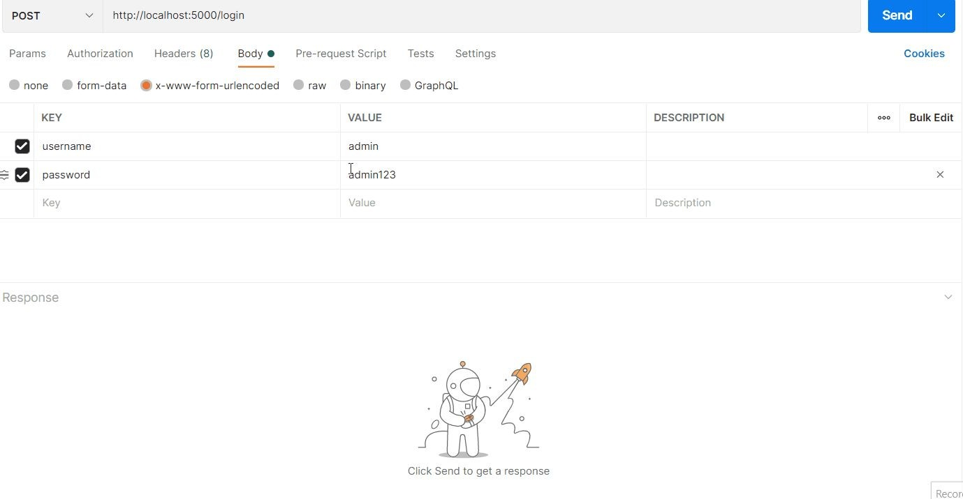
.env: The below code is for .env which is used to store your sensitive credentials like API keys:
PORT = 5000 ACCESS_TOKEN_SECRET=MYSECRETACCESS REFRESH_TOKEN_SECRET=MYREFRESHTOKENSECRET

Slide 115

Passport
Passport is the authentication middleware for Node. It is designed to serve a singular purpose which is to authenticate requests. It is not practical to store user password as the original string in the database but it is a good practice to hash the password and then store them into the database. But with passport-local-mongoose you don’t have to hash the password using the crypto module,
passport-local-mongoose will do everything for you. If you use passport-local-mongoose this module will auto-generate salt and hash ﬁelds in the DB. You will not have a ﬁeld for the password, instead, you will have salt and hash.

Slide 116
Why salting of password is needed
If the user simply hashes their password and if two users in the database have the same password, then they’ll have the same hash. And if any one of the passwords is hacked then the hacker can access every account using the same password because users with the same password will have the same hash ﬁelds.
So before we hash it, we prepend a unique string. Not a secret, just something unique. so the hash is completely different for every salt.

Slide 117
First let’s generate an express app, then install the needed modules
npm install passport passport-local mongoose passport-local-mongoose --save
1.First create a directory structure as below :
--model
----user.js
--route
----user.js
--app.js

Slide 118
2.Create model/user.js ﬁle which deﬁnes user schema
// importing modules
var mongoose = require('mongoose'); var Schema = mongoose.Schema;
var passportLocalMongoose = require('passport-local-mongoose');
var UserSchema = new Schema({
email: {type: String, required:true, unique:true}, username : {type: String, unique: true, required:true},
});

Slide 119
// plugin for passport-local-mongoose
UserSchema.plugin(passportLocalMongoose);
// export userschema
module.exports = mongoose.model("User", UserSchema);
Note that here in this schema we did not add any ﬁeld for password unlike we do normally. This is because passport-local-mongoose doesn’t need it. Here we did not add any methods to hash our password or to compare our passwords as we do normally for authentication because passport-local-mongoose will do all that for us.

Slide 120
3.Conﬁgure Passport/Passport-Local in app.js :
In app.js ﬁrst, you have to initialize the passport
app.use(passport.initialize());
app.use(passport.session());
The passport will maintain persistent login sessions. In order for persistent sessions to work in the passport, the authenticated user must be serialized to the session and deserialized when subsequent requests are made. With passport-local-mongoose it is
passport.serializeUser(User.serializeUser());
passport.deserializeUser(User.deserializeUser());

Slide 121
The serialize and deserialize code can be slightly different if you are not using passport-local-mongoose with the passport.
Now we have to deﬁne the strategies for passport. For passport local mongoose the code is
const User = require('./models/user');
const LocalStrategy = require('passport-local').Strategy;
passport.use(new LocalStrategy(User.authenticate()));
If you are using only passport without passport-local-mongoose the local strategy can be quite different i.e.) you will have to write code to compare passwords and all. Here just this 2 lines are enough

Slide 122
4.Create route/user.js ﬁle :
First import the user-schema along with other necessary modules
// importing modules
const express = require('express'); const router = express.Router();
// importing User Schema
const User = require('../model/user');

Slide 123
5.For registering :
Now for registering the code should be
router.post("/register", function (req, res) {
User.register(new User({ email: req.body.email, username: req.body.username }), req.body.password, function (err, user) {
if (err) {
res.json({ success: false, message: "Your account could not be saved. Error: " + err });
}
else {
req.login(user, (er) =& gt; { if (er) {

Slide 124
res.json({ success: false, message: er });
}
else {
res.json({ success: true, message: "Your account has been saved" });
}
});
}
});
});

Slide 125
See in the above code we did not deﬁne our password in New user. Instead, we use the password with the User.Register() which is a passport-local-mongoose function. Now if you check your database for your saved user, it will be like below
{
"_id" : ObjectId("5ca8b66535947f4c1e93c4f1"), "username" : "username you gave",
"email" : "email you gave",
"salt" : "4c8f6e009c4523b23553d9479e25254b266c3b7dd2dbc6d4aaace01851c9687c",
"hash" : "337de0df58406b25499b18f54229b9dd595b70e998fd02c7866d06d2a6b25870d23650
cdda829974a46e3166e535f1aeb6bc7ef182565009b1dcf57a64205b5548f6974b77c2e3a3c6aec5360d 55f9fcd3ffd6fb99dce21aab021aced72881d3720f6a0975bfece4922282bb748e0412955e0afa2fb8c9 f5055cac0fb01a4a2288af2ce2a6563ed9b47852727749c7fe031b6b7fbb726196dbdfeeb6766d5cba6a 055f66eeacce685daef8b6c1aed0108df511c92d49150efb6473ee71c5149dd06bfb4f73cb60f9815af0 1e02fde8d8ed822bb3a55f040237cf80de0b1534de6bbafcb53f882c6eb03de4b4aa307828974eb51261 661efb5155e68ad0e593c0f5fab7d690c2257df4369e9d5ac7e2fc93b5b014260c6f8fbb01034b3f85ec f11e086e9bf860f959d0e2104a1f825d286c99d3fc6f62505d1fde8601345c699ea08dcc071e5547835c 16957d3830998a10762ebd143dc557d6a96e4b88312e1e4c51622fef3939656c992508e47ddc148696df
3152af76286d636d4814a0dc608f72cd507c617feb77cbba36c5b017492df5f28a7a3f3b7881caf6fb4a 9d6231eca6edbeec4eb1436f1e45c27b9c2bfceccf3a9b42840f40c65fe499091ba6ebeb764b5d815a43 d73a888fdb58f821fbe5f7d92e20ff8d7c98e8164b4f10d5528fddbcc7737fd21b12d571355cc605eb36 21f5f266f8e38683deb05a6de43114",
"__v" : 0
}

Slide 126
5.For login :
Now for login
router.post("/login", function (req, res) {
if (!req.body.username) {
res.json({ success: false, message: "Username was not given" })
}

Slide 127
else if (!req.body.password) {
res.json({ success: false, message: "Password was not given" })
}
else {
passport.authenticate("local", function (err, user, info) { if (err) {
res.json({ success: false, message: err });
}

Slide 128
else {
if (!user) {
res.json({ success: false, message: "username or password incorrect" });
}
else {
const token = jwt.sign({ userId: user._id, username: user.username }, secretkey, { expiresIn: "24h" }); res.json({ success: true, message: "Authentication successful", token: token });
}
}
})(req, res);
}
});

Slide 129
6.Resetting or changing passwords :
You can reset or change passwords using 2 simple functions in passport-local-mongoose. They are setPassword function and changePassword functions. Normally setPassword is used when the user forgot the password and changePassword is used when the user wants to change the password.
for setPassword code is

Slide 130

// user is your result from userschema using mongoose id
user.setPassword(req.body.password, function(err, user){ .. For changePassword
// user is your result from userschema using mongoose id
user.changePassword(req.body.oldpassword, req.body.newpassword, function(err) ... You can directly call them in your router ﬁles
Git hub link : https://github.com/Lokeshrajarit/Group_6_FSD_Batch_A53

Slide 131


